Slide 1

Towards Robust Unsupervised Object Detection
A multi-layer Framework Using open-vocabulary zero-shot detector, vision-language models and segmentation for data annotation
Master Thesis
Student: Devashish singha Roy
Supervisor: homam mokayed
Date: 2025-06-04
LuleÅ university of technology

Slide 2
Project MARTINA
Supports with future AI Solutions for Small and Medium-sized Enterprises in Northern Sweden.
Financers: European Regional Development Fund, Norrbotten Region, Skellefteå Municipality, Luleå Municipality
Multiple ARTificial intelligence INnovations – Again
https://martinaprojektet.se/

Slide 3
Agenda
Background
Motivation
Objectives
Implementation
Results
Conclusion
Acknowledgements

Slide 4
Background
Aerial object detection is crucial for search and rescue operation, security, wildlife/environmental monitoring, surveillance, scene understanding etc.
AI development depends on large scale annotated data.
Manual annotation is expensive and unscalable
Aim: Unsupervised annotation

Slide 5
Motivation
SOTA Vision-language models such as Grounding Dino, Gemma3, Paligemma2 offers powerful open-vocab, zero-shot detection and semantic understanding capabilities.
Raw outputs from these models suffer from noise, redundancy and temporal inconsistencies.
So, motivation is to leverage the recent advancements in these models by combining their capabilities into a reliable and scalable multi-layered pseudo-labelling pipeline

Slide 6
Objectives
Design, implement, and evaluate an unsupervised pseudo-labelling framework
1
Investigate the role of Vision-language Models (VLMs) for noise filtration
2
Study threshold sensitivity in zero-set detector Grounding Dino
3
Explore spatial and temporal enhancement (windowing, SAM2).
4
Assess prompt sensitivity of zero-set detectors/VLMs
5

Slide 7
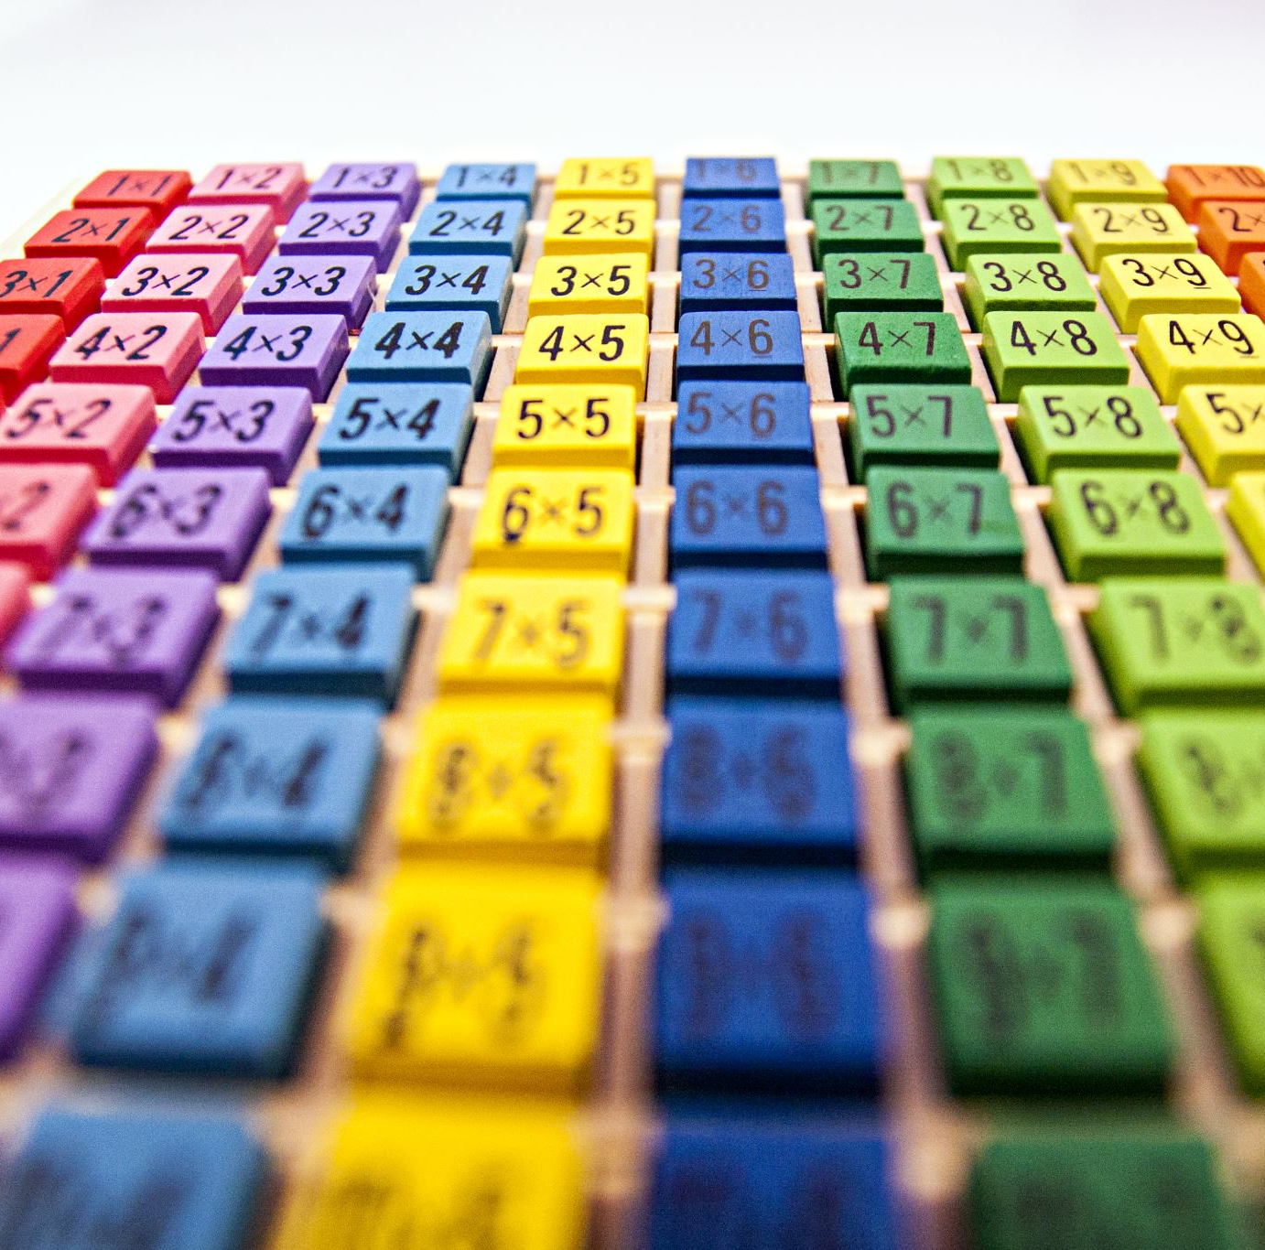
Implementation
A multi-layer Framework Using Grounding DINO, SAM2, and Vision-Language Models for pseudo-labelling un-annotated data

Slide 8
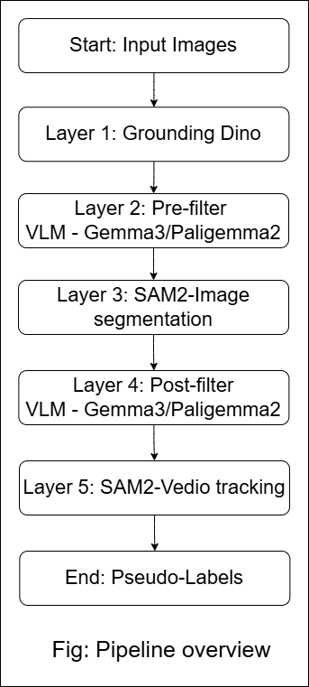
Key techniques
Zero-Shot Detector (Grounding DINO) as base detector
Vision-Language model for filtering noise (Gemma3 / Paligemma2)
Segment Anything Model (SAM2) for segmentation and temporal tracking

Slide 9
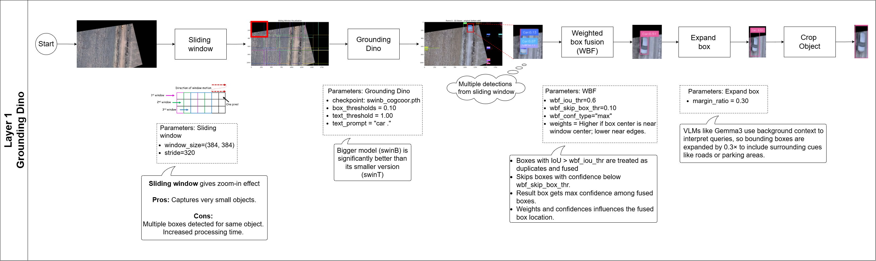
Layer 1 : Grounding Dino

Slide 10
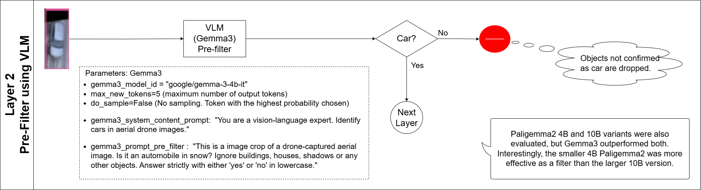
Layer 2 : Pre-filter – VLM as judge

Slide 11
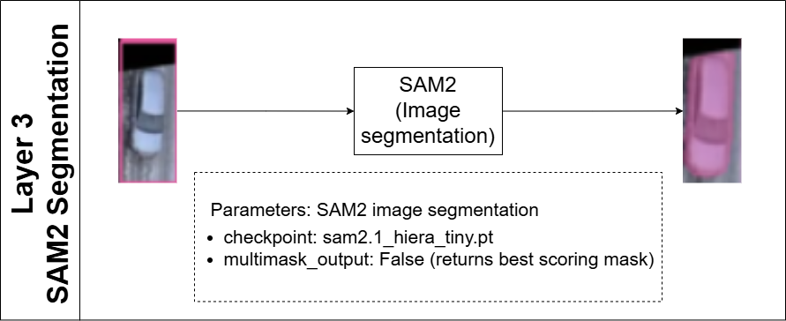
Layer 3 : SAM2 Image segmentation

Slide 12
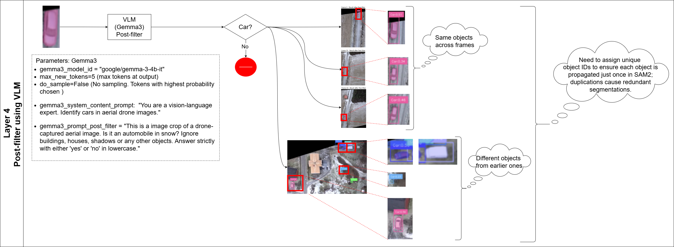
Layer 4 : Post-filter – VLM as judge

Slide 13
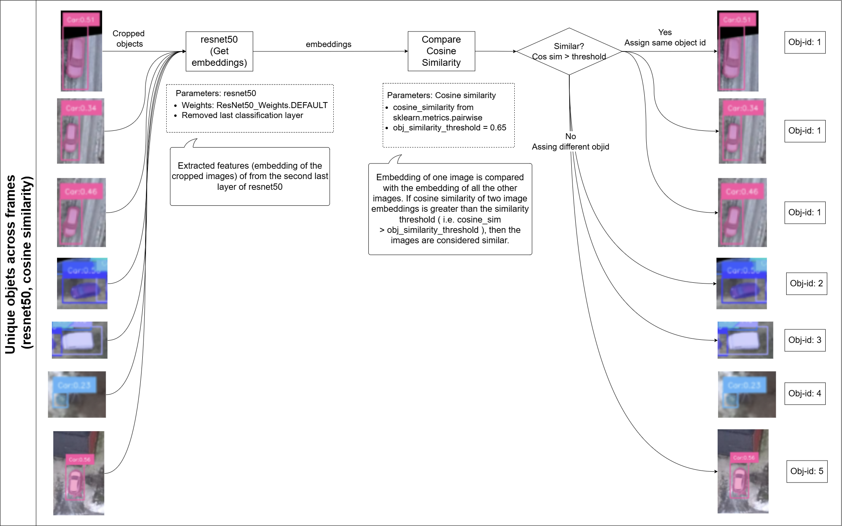
Unique object ids across frames

Slide 14
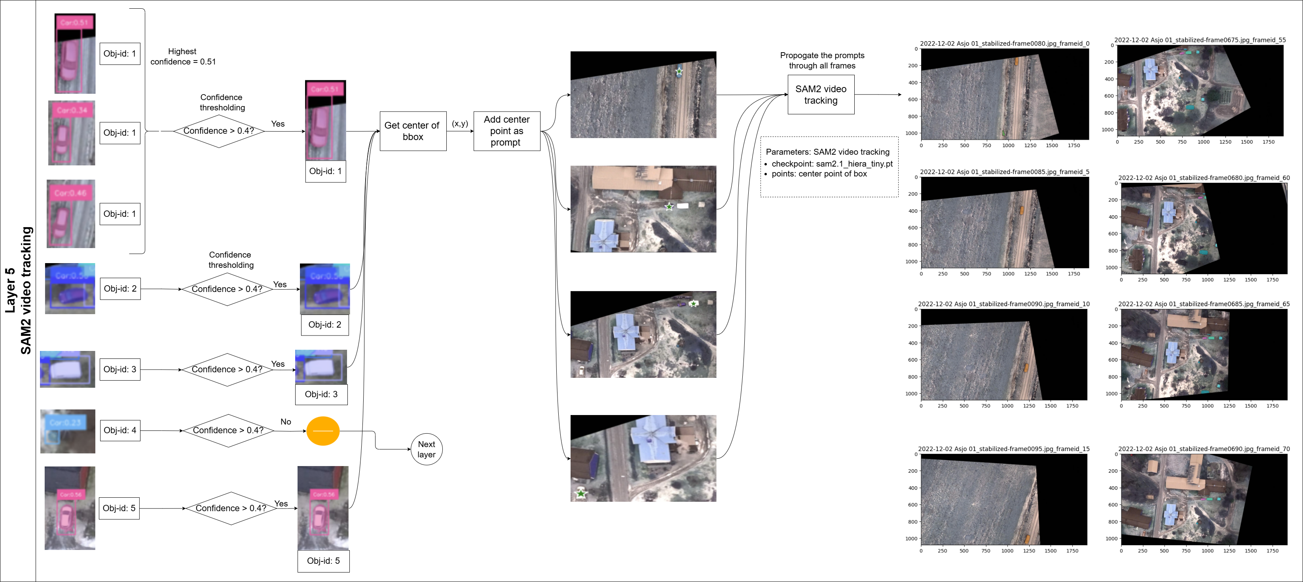
Layer 5 : SAM2 video tracking

Slide 15
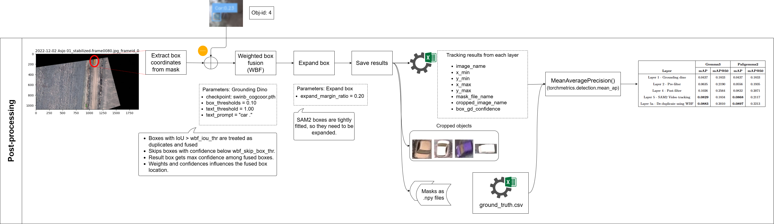
Post-processing

Slide 16

Experimental setup
Test data: 100/500 images from Nordic vehicle dataset(NVD). https://nvd.ltu-ai.dev/
GPU : NVIDIA H100 via university remote cluster
Evaluation metrics:
mAP (Mean Average Precision) and mAP50
mAP50 measures detection quality at IoU ≥ 0.5.
mAP averages performance across IoU thresholds from 0.5 to 0.95.

Slide 17

Results

Slide 18
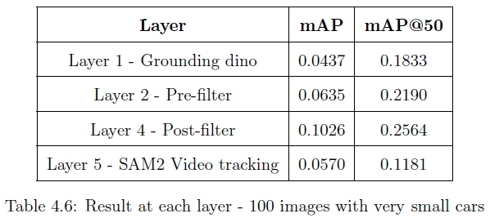
Test set – 100 Images – Contains small cars
Key configuration
Grounding Dino Box threshold: 0.10
VLM – Gemma3
Discussion
Lower box threshold 0.10 needed for small targets
Progressive improvement across layers, except for last
Pre-filter and Post-filter improves result, confirming need for VLM based filtration
SAM2 video tracking amplified noise from earlier layers, suggesting need for selective propagation

Slide 19
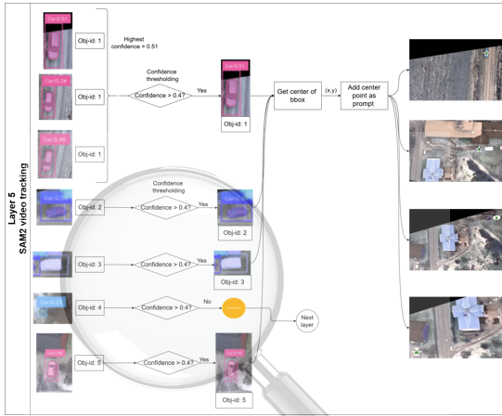
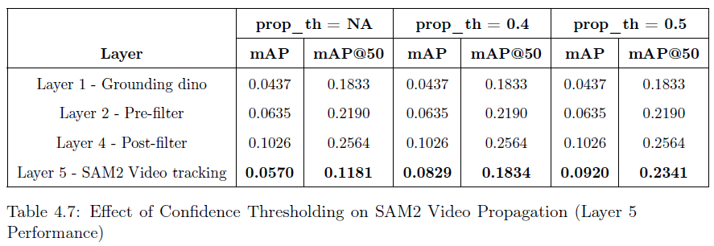
Confidence thresholding @ Layer 5 - SAM2 video tracking
Key configuration
Test set – 100 Images – Contains small cars
GD Box threshold: 0.10, VLM – Gemma3
Confidence threshold (prop_th) > 0.4, 0.5
Discussion
mAP increase by 61%, mAP50 increases by 98% compared to no thresholding, with confidence threshold of 0.5.

Slide 20
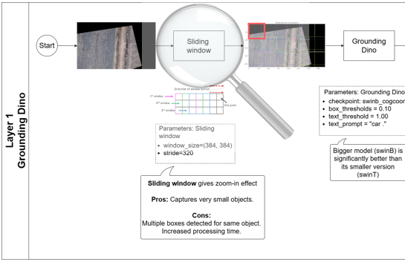
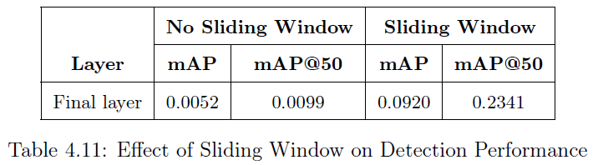
Need for sliding window
Key configuration
Test set – 100 Images – Contains small cars
Grounding Dino Box threshold: 0.10
Sliding window: (384, 384), Stride: 320
Discussion
With sliding window, mAP increases by 18 times whereas mAP50 increases by 23 times.

Slide 21
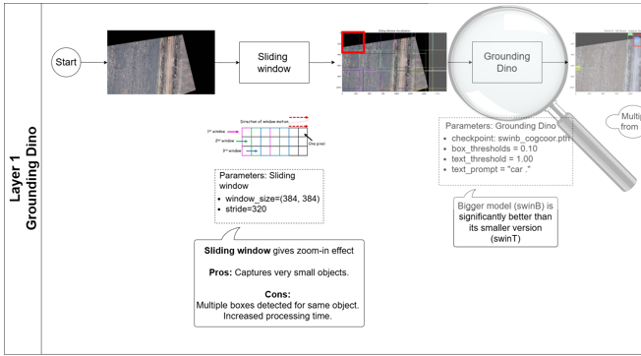
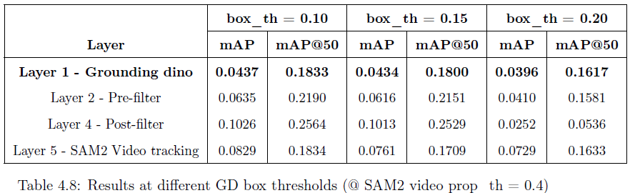
Grounding Dino Box Threshold Comparison
Key configuration
Test set – 100 Images – Contains small cars
GD Box threshold: 0.10, 0.15, 0.20, VLM – Gemma3
Discussion
Choice of box threshold has significant impact
Lowest thresholds 0.10 gets best mAP/mAP50
Later layers cannot recover missed objects, so lower threshold at base detector is preferred

Slide 22
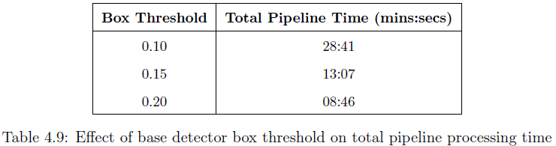
Effect of GD box threshold on compute time
Key configuration
Test set – 100 Images – Contains small cars
Grounding Dino Box threshold: 0.10, 0.15, 0.20
Discussion
Lower box thresholds preserve more true positives but also introduce noise, increasing data volume and processing time.
For e.g., lowering from 0.20 to 0.10 raises pipeline time by over 3times (227%).

Slide 23
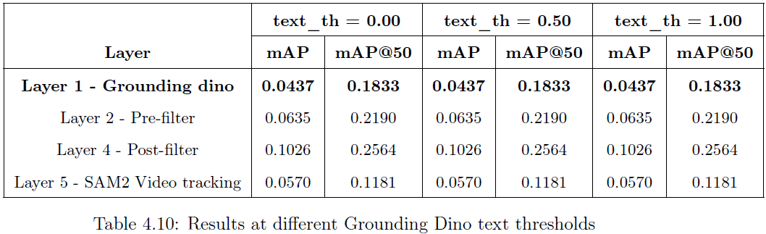
Grounding Dino Text Threshold Comparison
Key configuration
Test set – 100 Images – Contains small cars
GD Box threshold: 0.10
GD Text thresholds: 0.00, 0.50, 1.00
GD Text prompt: “car .”
Discussion
Varying text threshold has no impact on detection performance
Could be because of text prompt. Should be tested with more open-vocab prompts

Slide 24
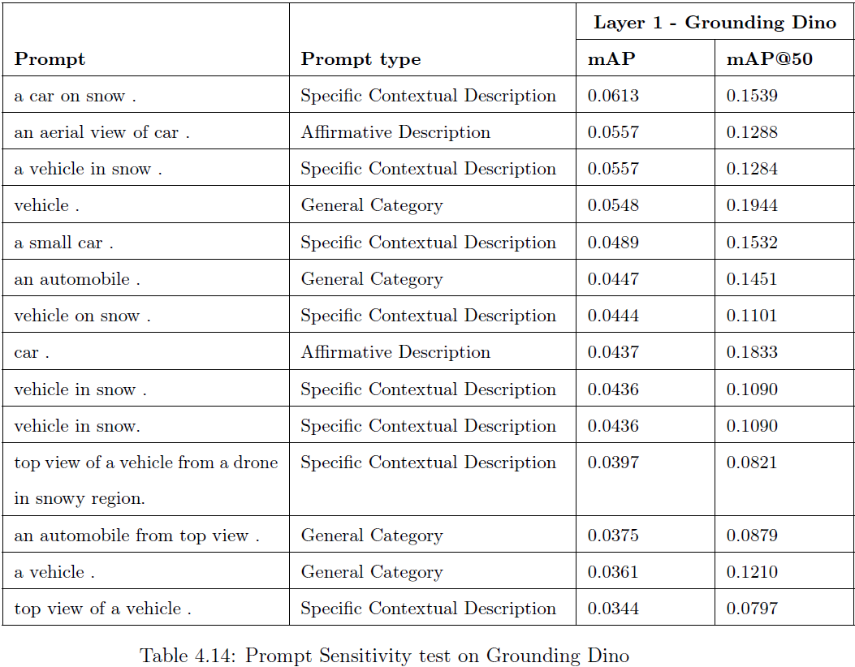
Prompt Sensitivity test Grounding dino
Key configuration
Test set – 100 Images – Contains small cars, GD Box threshold: 0.10
Discussion
Contextual prompts with environmental cues (e.g., “on snow”, “aerial view”) results in higher mAP compared to generic prompts like “vehicle” or “car”

Slide 25
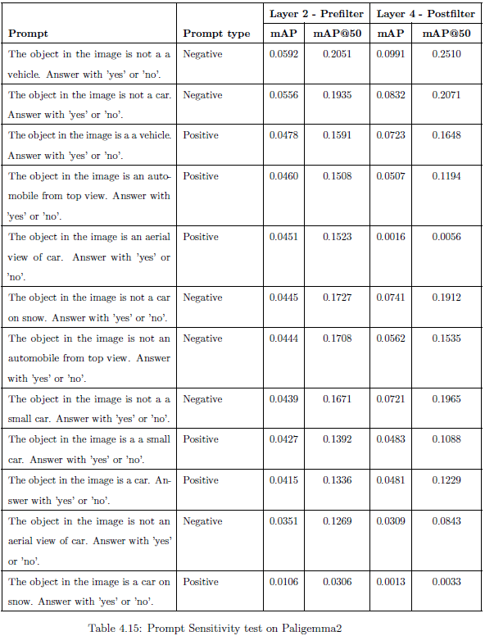
Prompt Sensitivity test Paligemma2
Key configuration
Test set – 100 Images – Contains small cars, GD Box threshold: 0.10, Sliding window: (384, 384), Stride: 320, VLM: Paligemma2
Discussion
Negative prompts like “not a vehicle” performs better, with up to 2 times higher mAP than positive prompts

Slide 26
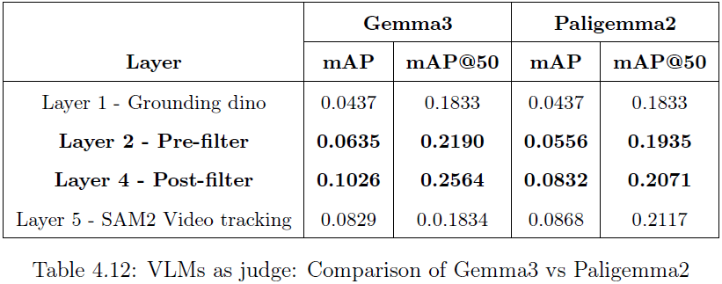
VLMs as judge Gemma3 vs Paligemma2
Key configuration
Test set – 100 Images – Contains small cars
Grounding Dino Box threshold: 0.10
VLM: Gemma3, Paligemma2
Sliding window: (384, 384), Stride: 320
Discussion
Gemma3 - Better recall but noisy
Paligemma2 – Cleaner output, higher precision
Gemma3 approximately 1.8 times slower than Paligemma2

Slide 27
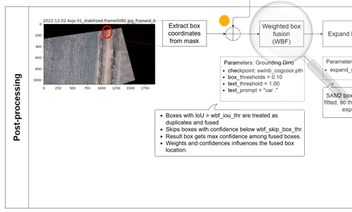
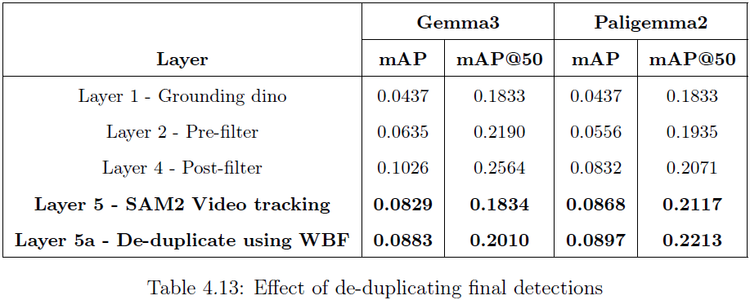
Effect of de-duplicating final detections
Key configuration
Test set – 100 Images – Contains small cars
GD Box threshold: 0.10, WBF after layer 5
Discussion
mAP improves by 6.5% (Gemma3) and 3.3% (Paligemma2), similar gains in mAP50

Slide 28
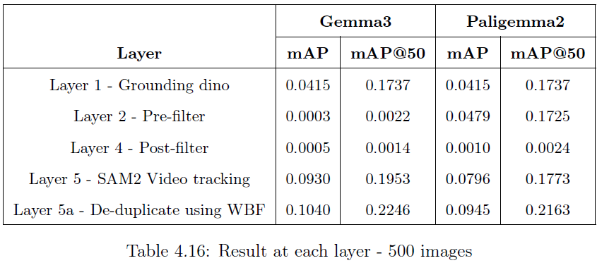
Test set – 500 Images - Consistency and scalability test
Key configuration
GD Box threshold: 0.10, VLM: Gemma3, Paligemma2, Sliding window: (384, 384), Stride: 320, Layer 5 SAM2 Confidence threshold (prop_th) > 0.4, Applied WBF after layer 5
Discussion
Gemma3: Over-filtered, near-zero at Layer 2 & 4
Paligemma2: More stable, especially at pre-filter
SAM2 video tracking recovered performance
De-duplicating final detections improved results

Slide 29

Conclusion

Slide 30

Limitations
VLM Judgment is prompt-sensitive thus requires careful prompt engineering
Only tested on Nordic vehicle dataset. Generalization to other domains remains unverified
Only tested with Grounding Dino. Results may vary with other zero-shot detectors like OWL-ViT or GLIP.
Use of SAM2 temporal tracking adds significant processing time
For SAM2 temporal tracking to be effective, noisy detections must be properly filtered in early stages

Slide 31
Key Outcomes Aligned with Objectives
Obj. 1: Successfully designed, developed and evaluated, a multi-layer, unsupervised pseudo-labelling framework for aerial object detection.
Obj. 2: Gemma3 detects more but is noisier and 1.8x slower; Paligemma2 is cleaner but misses some targets.
Obj. 3: Lower box threshold improved recall but increased noise and compute. Text threshold had negligible impact.
Obj. 4: Windowing improved detection of small objects. SAM2 video tracking enhanced temporal consistency, particularly when only high-confidence detections were propagated.
Obj. 5: Grounding DINO and Paligemma2 are both sensitive to prompt. Contextual and negative prompts yielded better results.
Implement unsupervised pseudo-labelling framework
1
Investigate the role of VLMs in noise filtration
2
Study threshold sensitivity in Grounding Dino
3
Explore spatial and temporal enhancement (windowing, SAM2)
4
Assess prompt sensitivity of zero-set detectors/VLMs
5

Slide 32
Future Work
Improve Base Detection: Test new prompts for Grounding DINO.
Explore other zero-shot detectors like OWL-ViT or GLIP.
1
Scale to Larger Datasets: Test on diverse datasets (e.g., DOTA) with varied scenes and object categories to assess generalization.
2
Leverage Newer VLMs: Try advanced models like CLIP or LLaVA for better semantic filtering.
3
Modular Pipeline Extensions: Enable configurable detectors, filters.
4

Slide 33

Acknowledgements
Sincere thanks to
Dr. Homam Mokayed, Supervisor
Dr. Chang Liu, Post doc researcher
LTU for providing advanced GPU cluster equipped with NVIDIA H100 hardware

Slide 34

Thank you!
I welcome your questions!

